Slide 1
Feature Extraction
By Dr. Ali Saeed

Slide 2
Lecture Outline
What is feature extraction
Feature extraction from text
  TFIDF Feature Extraction
  Bag of Words (BoW)
  N-gram method
  Word Embeddings
Feature extraction from images
  Local Binary Pattern (LBP)

Slide 3
What is feature extraction
Feature extraction refers to the process of transforming raw data into numerical features that can be processed while preserving the information in the original data set.
Feature Extraction aims to reduce the number of features in a dataset by creating new features from the existing ones

Slide 4

Example of TF-IDF on custom dataset
Data Set
Vocabulary | i | love | machine | learning | is | fun | deep | and
D1: “I love machine learning” | 0.044 | 0.044 | 0.000 | 0.000 | 0.000 | 0.000 | 0.000 | 0.000
D2: “Machine learning is fun” | 0.000 | 0.000 | 0.000 | 0.000 | 0.119 | 0.119 | 0.000 | 0.000
D3: “I love deep learning and machine learning” | 0.025 | 0.025 | 0.000 | 0.000 | 0.000 | 0.000 | 0.068 | 0.068
Notes:
# Import Libraries
import pandas as pd
from sklearn.model_selection import train_test_split
from sklearn.preprocessing import LabelEncoder
from sklearn.neighbors import KNeighborsClassifier
from sklearn.metrics import accuracy_score
from sklearn.feature_extraction.text import TfidfVectorizer
# Sample Text Dataset (replace with your CSV if needed)
data = {
"text": [
"I love machine learning",
"Machine learning is amazing",
"I hate spam emails",
"Spam emails are annoying",
"I love AI",
"AI is the future"
],
"label": ["positive", "positive", "negative", "negative", "positive", "positive"]
}
df = pd.DataFrame(data)
# Features and Labels
X = df["text"]
Y = df["label"]
# Apply TF-IDF Vectorization
vectorizer = TfidfVectorizer()
X = vectorizer.fit_transform(X)
# Encode Labels
le = LabelEncoder()
Y = le.fit_transform(Y)
# Train-Test Split
X_train, X_test, Y_train, Y_test = train_test_split(
X, Y, test_size=0.3, random_state=42
)
# Train Model (KNN)
model = KNeighborsClassifier(n_neighbors=3)
model.fit(X_train, Y_train)
# Predictions
Y_pred = model.predict(X_test)
# Accuracy
print("Predictions:", Y_pred)
print("Accuracy:", accuracy_score(Y_test, Y_pred))

Slide 5
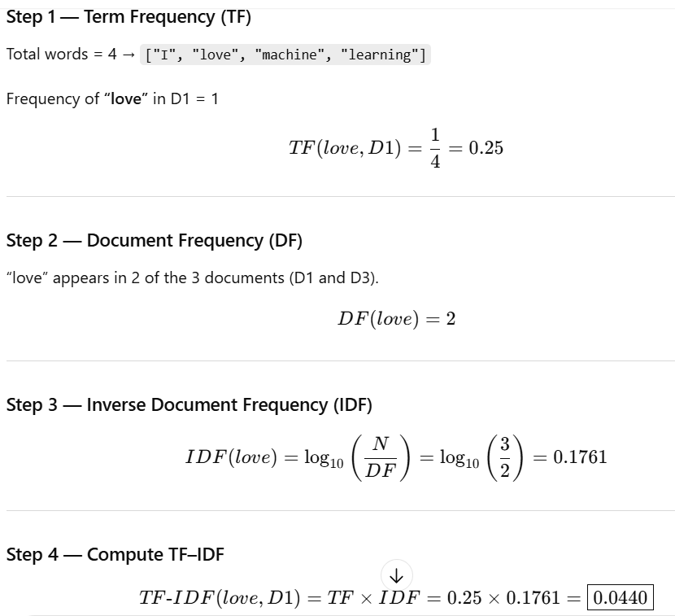
TF-IDF of word “love”

Slide 6
Feature Extraction from Text (Bag of Words)
Bag of words is a Natural Language Processing technique of text modelling.
Bag of words technique converts text into vectors
Machine learning algorithms prefer structured, well defined fixed-length inputs and by using the Bag-of-Words technique we can convert variable-length texts into a fixed-length vector.

Slide 7
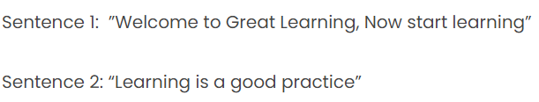
Bag of Words (BoW) Example
Let we have following two sentences:

Slide 8
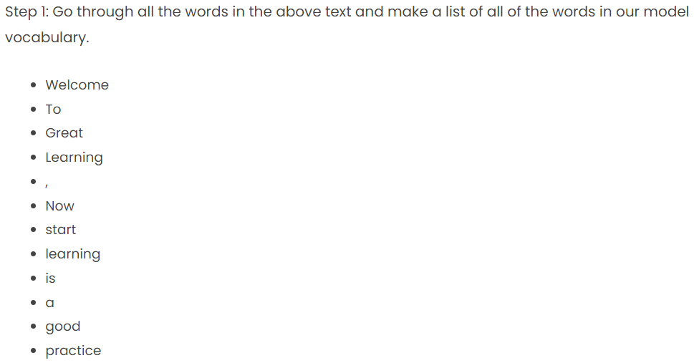
Step 1

Slide 9
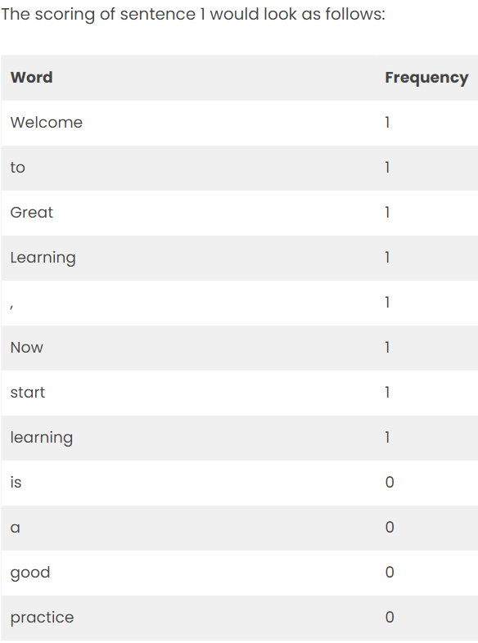

Step 2
(Sentence 1- Scoring)

Slide 10
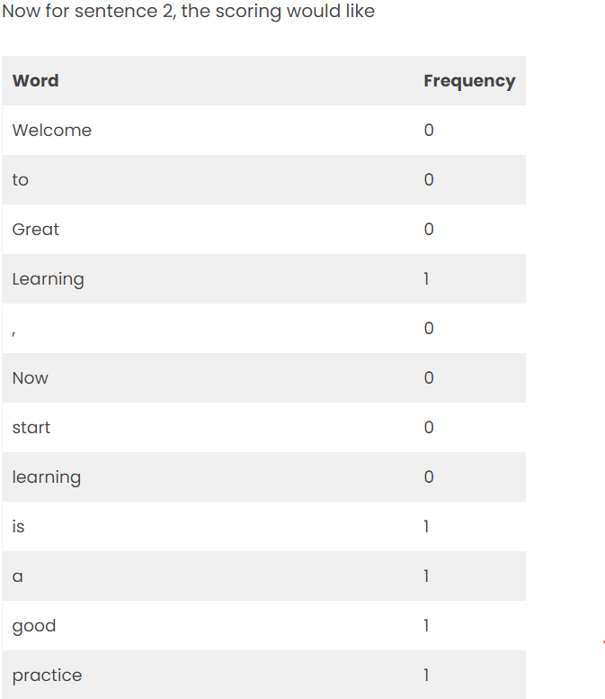

Step 3
(Sentence 2- Scoring)

Slide 11
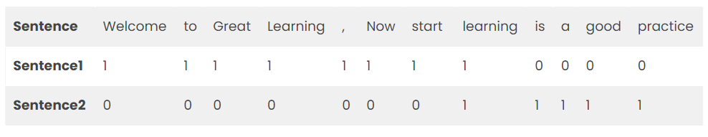
Step 4 - Dataset
We can easily apply Naïve Bayes, OneR or any other Machine Learning algorithm on above dataset

Slide 12
Class Exercise
Develop feature vectors using BoW on the following sentences:
  Sentence 1:- He is moving to school
  Sentence 2:- She is not moving to college
  Sentence 3:- He likes school and college

Slide 13
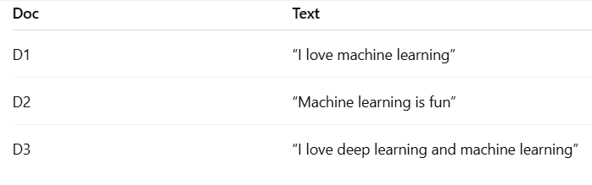
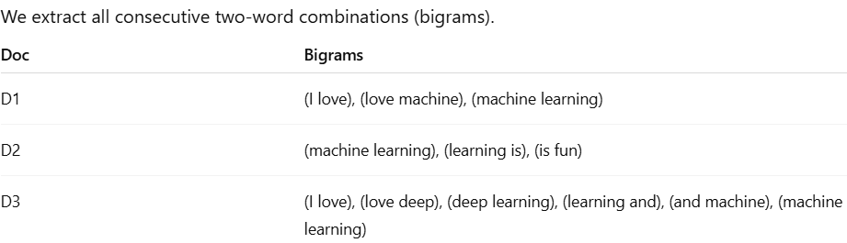
N- Gram model as Feature (Bi-Grams) like

Slide 14
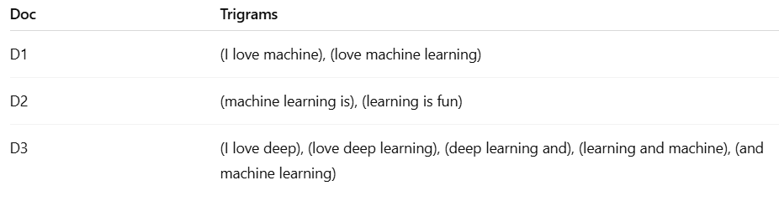
N- Gram model as Feature (Tri-Grams) like

Slide 15
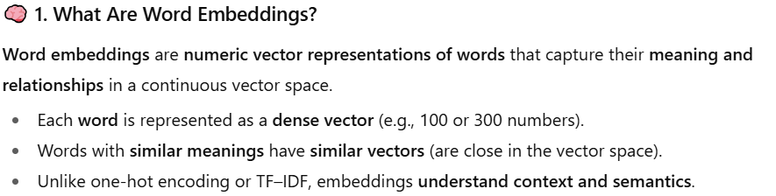
Word Embeddings as Feature

Slide 16
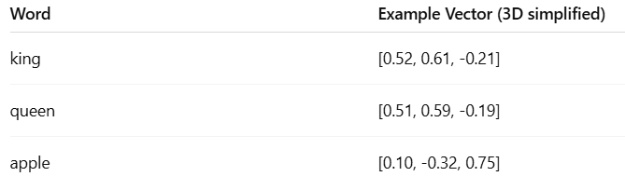

Word Embeddings Example

Slide 17
Feature extraction from images-(Local Binary Pattern)
As the name suggests, Local Binary Pattern (LBP for short) is a feature of the local representation of an image.
Local Binary Pattern (LBP) is an effective texture descriptor for images which thresholds the neighboring pixels based on the value of the current pixel
LBP descriptors efficiently capture the local spatial patterns and the gray scale contrast in an image.
Image Types
  Gray Scale
  Colored Images

Slide 18
Local Binary Pattern (LBP)
LBP has wide range of applications:
  Face Detection
  Object Detection
  Facial expression recognition
  Remote Sensing

Slide 19


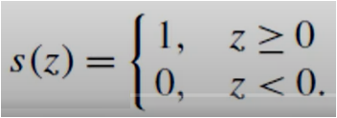
LBP-Example
It works on the concept of 3x3 window
It works on the basis of following formula:

Slide 20
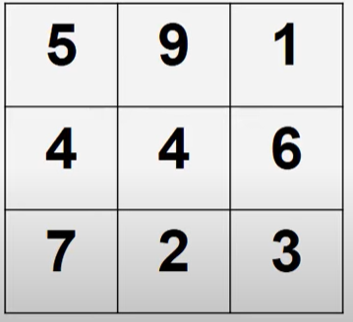
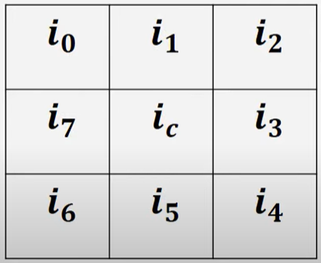
Example of 3x3 window size (Step 1)
1 | 1 | 0
1 |  | 1
1 | 0 | 0

Slide 21
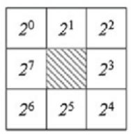
Step 1 (Compute value)
1 | 1 | 0
1 |  | 1
1 | 0 | 0
203 Value

Slide 22
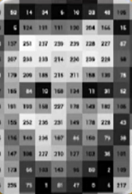
Final Image
Feature extraction is a part of the dimensionality reduction process:

Slide 23
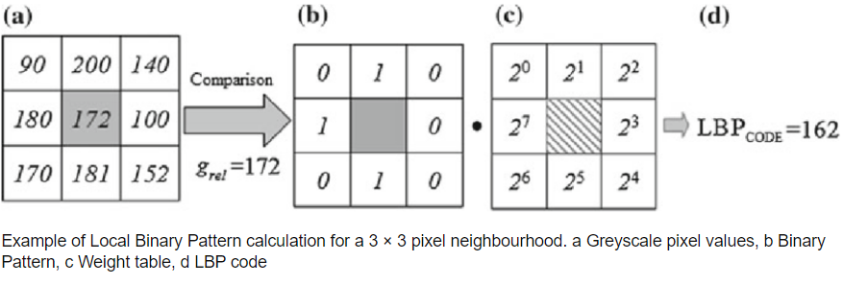
LBP Example

Slide 24
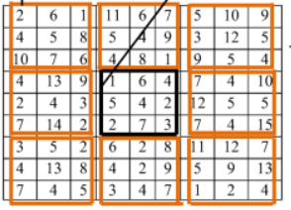
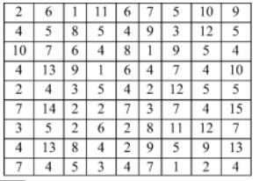
Movement of Window in LBP
A single window

Slide 25
Class Exercise
Compute LBP value of the following image (gray-scale values are given):
20 | 30 | 15
65 | 35 | 90
33 | 22 | 11

Slide 26
Thanks

